Slide 1
Air-BNB
Travel Data Analysis

Slide 2
Objective
Problem Statement
Air BNB has aimed to expand on travelling possibilities and present more unique, personalized ways of experiencing destinations. The analysis aims to draw insights from the data obtained from the listing activity of homestays in New York City. Some research questions need to be answered with respect to all the listings of past booking information.
Develop a Report by Extracting-Transforming-Loading of data which contains listings of the past booking information.
Analyze the data with respect to the Host, the neighbourhood, and customer pricing and reviews.

Slide 3
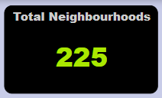
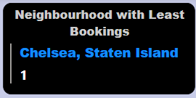
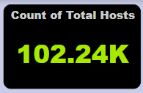
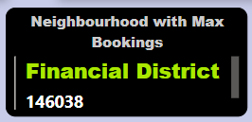
Key Insights

Slide 4
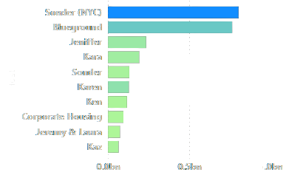
Top Earning Hosts in New York City

Slide 5
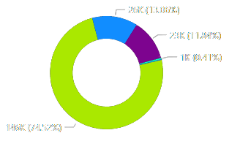
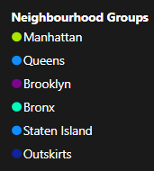
Maximum Bookings observed in the Manhattan Neighbourhood Group
Manhattan

Slide 6
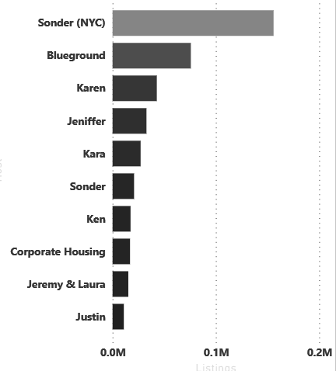
Top Hosts having bookings in Manhattan
All the top earning hosts are also the ones having maximum bookings in Manhattan

Slide 7
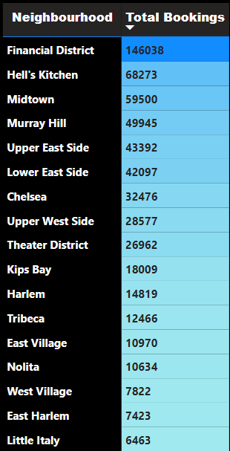
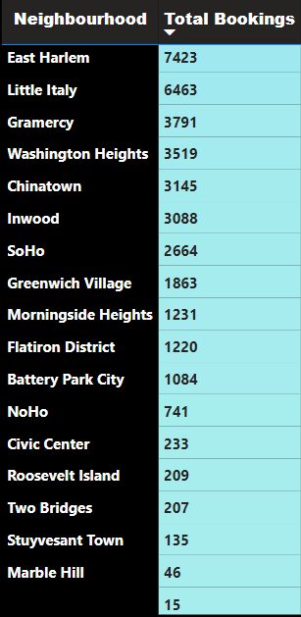
Neighbourhoods in Manhattan
All the neighbourhoods in Manhattan have the maximum bookings overall

Slide 8
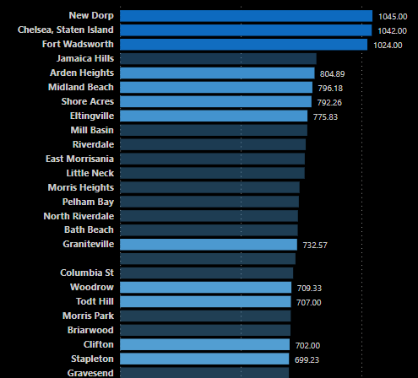
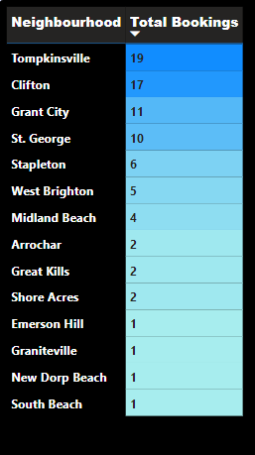
Relation between Pricing and Neighbourhood bookings
Average Pricing
Neighbourhoods with the highest average pricing have less number of bookings

Slide 9
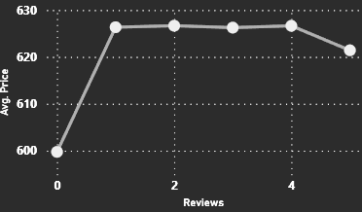
Relation between pricing and reviews
Average pricing is mostly unwavering for every rating

Slide 10
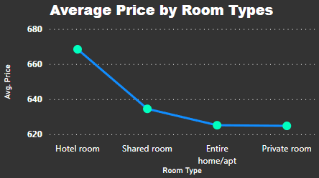
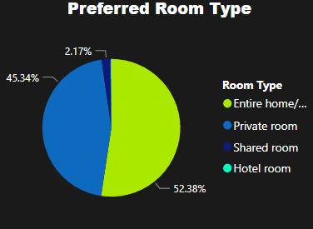
Relation between Pricing and Room types
Drastic difference seen between the average pricing of room types. Entire Home/ apt and Private room being almost the same
Mostly preferred room types Entire Home/ apt, Private Rooms are the ones having less average pricing

Slide 11
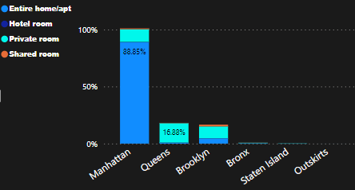
Room Type and Neighbourhood Groups
Manhattan has the highest number of bookings, 88% of which are Entire home/ apartments

Slide 12
Conclusions
Highest number of bookings are seen in the Manhattan Neighbourhood Group
The top earning hosts in New York City are the ones having maximum percentage of bookings in the Manhattan Neighbourhood Group making it the most preferred area by customers.
Neighbourhoods with the highest average pricing are the ones that have less number of bookings
Average pricing in relation with the reviews is almost the same for every review score out of 5
The mostly preferred room types are Entire Home/ Apartments, Private Rooms
Entire Home/ apt, Private Rooms are also the ones having less average pricing
Manhattan has the maximum bookings and 88% of which are bookings of Entire Homes/ Apartments

